Slide 1


Components of NLP Session No.: 2 Course Name: Natural Language Processing Course Code: R1UC616C Instructor Name: Mr. Amit Yadav Duration: 50 mins

Slide 2
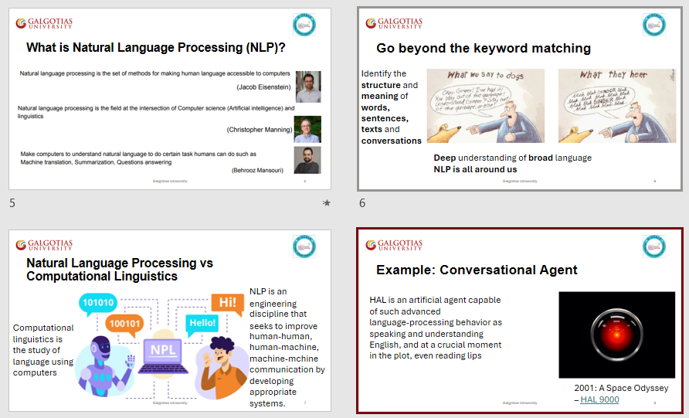
Review of the key concepts of session no. 1

Slide 3
Reflect on the responses of post session activity

Slide 4

"Looking at this image, What are the underlying processes that allow a device to understand and respond to human speech?"

Slide 5
At the end of this session students will be able to
Learning Outcome 1: Explain and differentiate the roles and functions of the five key components of NLP: Morphological and Lexical Analysis, Syntactic Analysis, Semantic Analysis, Discourse Integration, and Pragmatic Analysis.

Slide 6
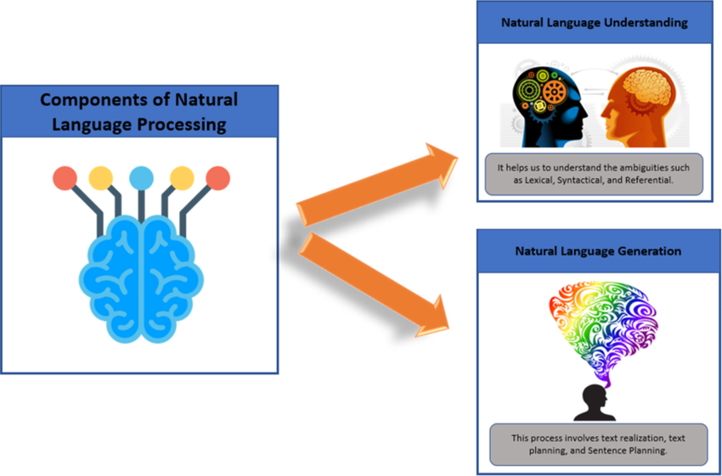
Components of NLP

Slide 7

Learning Activity 1: MCQ
Answer the given questions via scanning the wooclap code
Go to wooclap.com
Enter the event code in the top banner
Event code
NLPL2

Slide 8
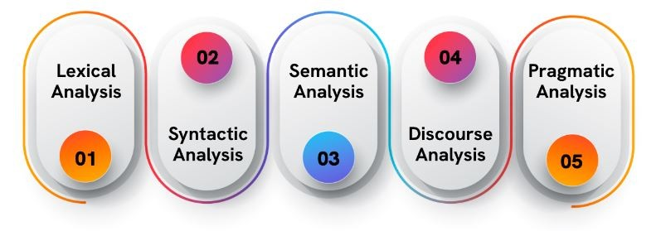
Components of NLP

Slide 9
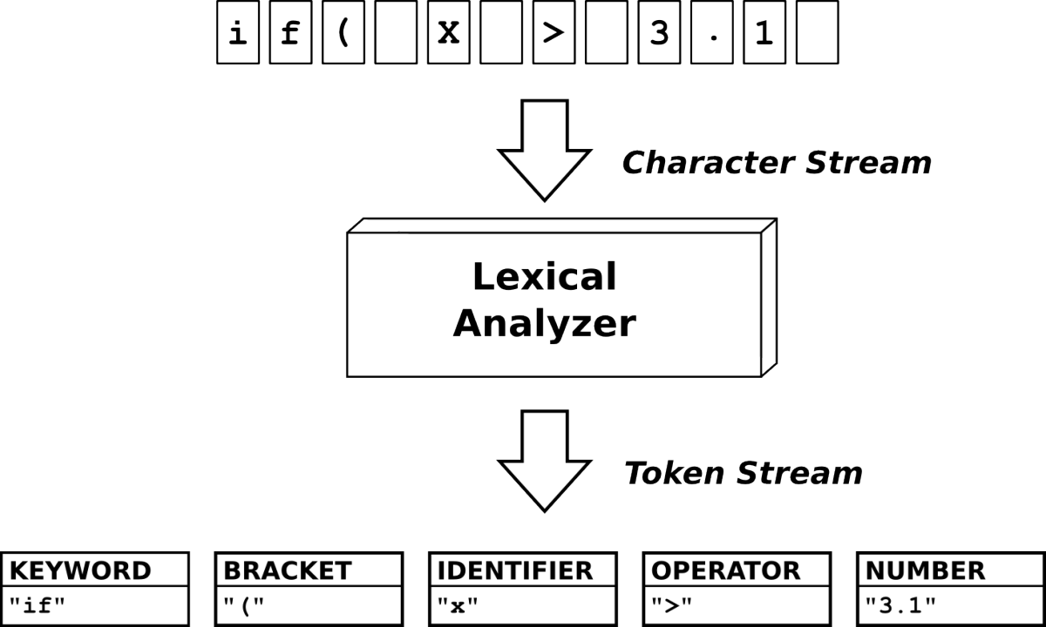
Lexical Analysis
In lexical analysis, we analyze the structure of words. This is also known as morphology. We look at the root of the word, the affixes, and the word shape. We also look at how the word is used in context. This can help us to understand the meaning of the word.

Slide 10
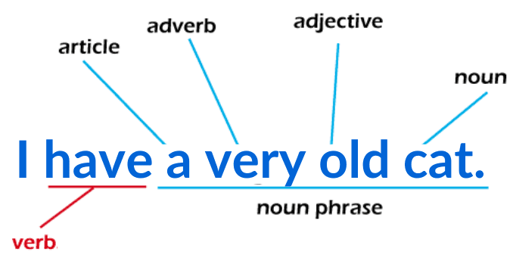
Syntactic Analysis
Syntactic analysis in NLP involves breaking down sentences into their grammatical components, such as nouns, verbs, adjectives, and their relationships, enabling machines to comprehend the structure and meaning of text.

Slide 11

Semantic Analysis
Semantic analysis is the process of finding the meaning from text. This analysis gives the power to computers to understand and interpret sentences, paragraphs, or whole documents, by analyzing their grammatical structure, and identifying the relationships between individual words of the sentence in a particular context.
For Example,
Consider the word: Orange
The above word can refer to a color, a fruit, or even a city in Florida!

Slide 12
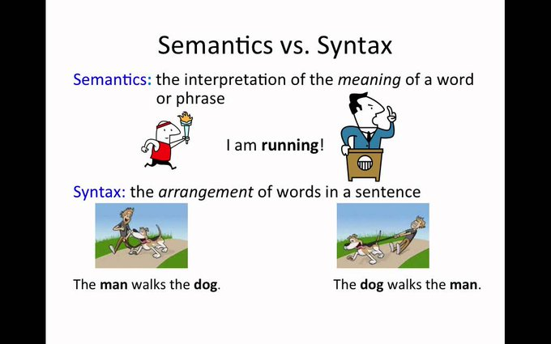
Syntax vs. Semantics
Syntax refers to the grammatical rules of a language
Semantics refers to the meanings of words.

Slide 13
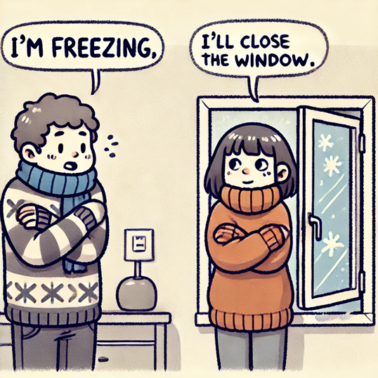
Discourse Analysis
Discourse focuses on the analysis and interpretation of language beyond the sentence level, considering how sentences relate to each other in texts and conversations.
e.g. In a conversation where one person says, "I’m freezing," and another responds, "I’ll close the window," discourse involves understanding the coherence between the two statements, recognising that the second statement is a response to the implied request in the first.

Slide 14

Programmatic Analysis
Pragmatics: knowledge of the relationship of meaning to the goals and intentions of the speaker
e.g. the sentence “What time do you call this?!” does not mean “the teacher is asking her for the time”. This is the semantic meaning of the sentence. Here, it is referred to as “Why are you so late?” which is the pragmatic meaning of the sentence.

Slide 15

Learning Activity 2: Think Pair Share
Grouping: At each table, assign one of the five NLP components—Lexical, Syntactic, Semantic, Discourse, and Programmatic Analysis—to each student. If more than five students are at a table, some should pair on the same component.
Think (5 minutes) Task: Independently analyze how your assigned component processes the sentence: 'The quick brown fox jumps over the lazy dog.' Consider your component’s specific role.
Pair (5 minutes) Task: Discuss with your neighbor how your components analyze the sentence. Note similarities and differences in your findings.
Share (5 minutes) Task: Present your combined insights to your table. Evaluate how each component contributes to understanding the sentence.
Submit (5 minutes) Task: Finalize your individual analysis, integrating insights from discussions. Submit through Wooclap, ensuring your response reflects a deep understanding of your component.
code GKMGHG

Slide 16
Reflection- Learning Activity 1

Slide 17
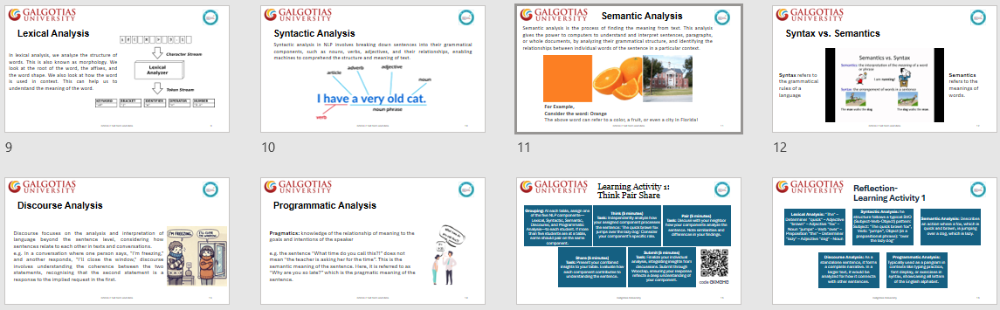
Summary

Slide 18
Ensure attainment of LOs in alignment to the learning activities: outcomes (1-2)
Outcome 1: Explain and differentiate the roles and functions of the five key components of NLP (Think Pair Share activity)

Slide 19
Discussion on the post session activities

Slide 20
Information about the next lesson

Slide 21

Review and Reflection from students

